Slide 1



Alcohol Consumption Analysis
Group Project 1
Alcoholics Anonymous
Jacob Cortez
Karina Horna
Julian Louden
Reinhard Ndlovu
Dan Tinarwo

Slide 2

Agenda
Project Overview
Objectives and Key Results
Data sources & collection method
Cleaning and merging data sources
Visualizations and analysis
Summary
Findings
Project limitations
Q & A

Slide 3




Project Overview
Chosen Project
Analysis of alcohol consumption worldwide and the correlation between consumption and countries in relation to their:
Employment rates
Suicide rates
Urban rates
Income per person
Project Objectives & Key Results
Find good data sources that can be merged to produce insight
Analyze our data set and extract clear insights.
Build visuals that tell a compelling story.
Data Sources
Alcohol consumption CSV by country from Kaggle.
Country coordinates from Canolical country data.
Google maps API to triangulate and visualize heat map.

Slide 4

Cleaning & Merging Data
Cleaning the Data
Merging Data Sources
Cleaned the CSV using:
DropNa Jupyter function
Filtering for relevant data using a top 10 and 30 function to call the data set for our visuals.
Converted the excel xls file to GeoJSON for the Gmaps visualization
Renamed column names correcting spelling errors and organizing data.
Merged the cleaned up columns.
Merged our Kaggle country data with coordinates from Canolical country data.
Created a google API to call data and represent it on a world (heat) map.

Slide 5

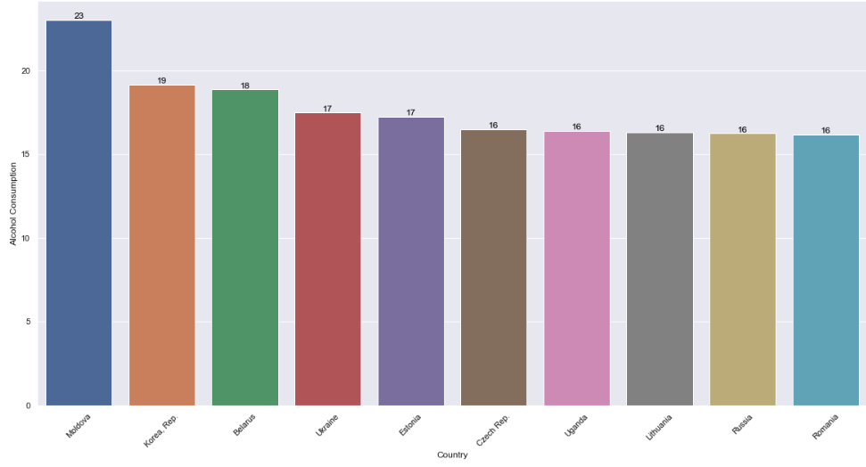
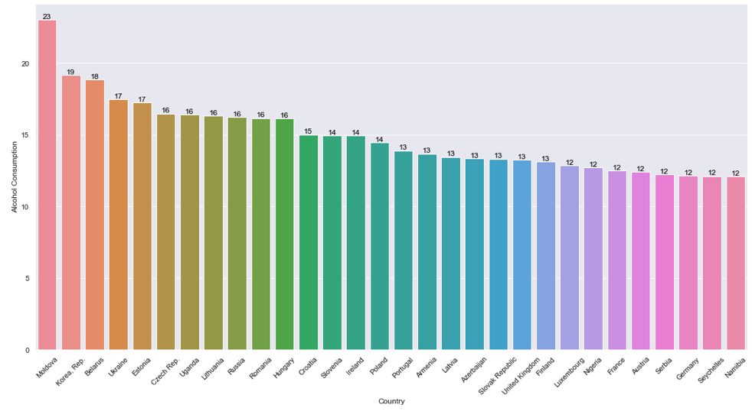
Visualizations - Bar Charts
Top 10 Countries
Top 30 Countries

Slide 6
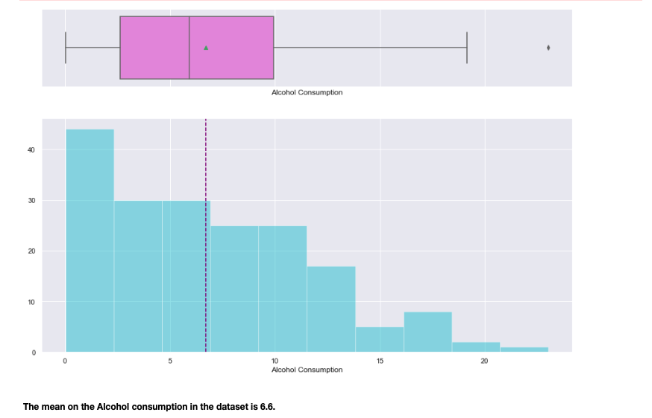
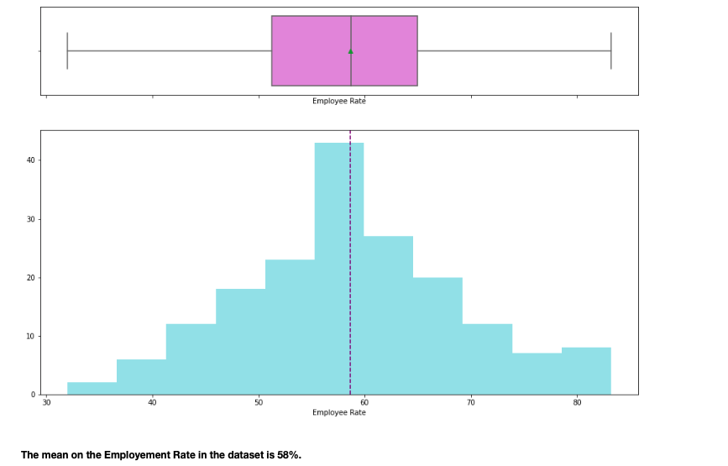
Visualizations – Histogram
Alcohol Consumption Data
Employment Data

Slide 7
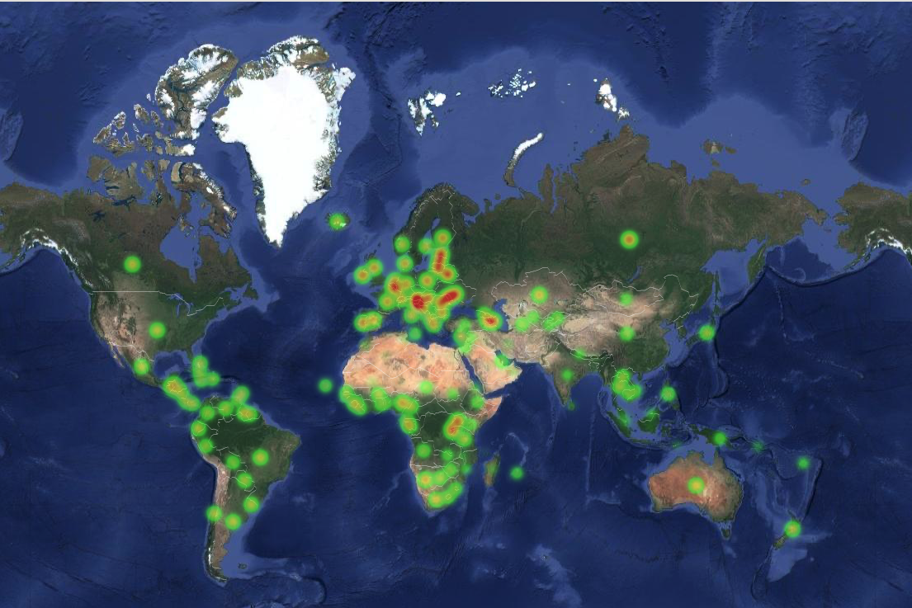
Visualizations – World Heat Map

Slide 8
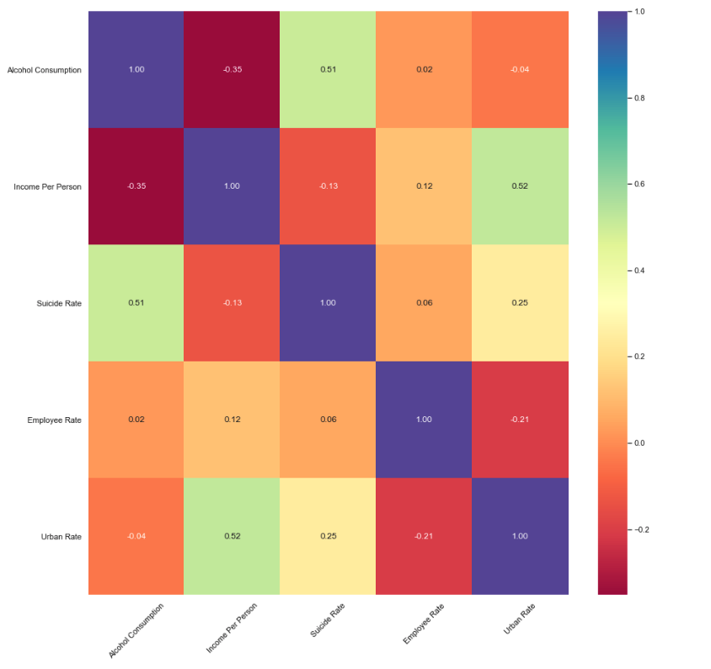
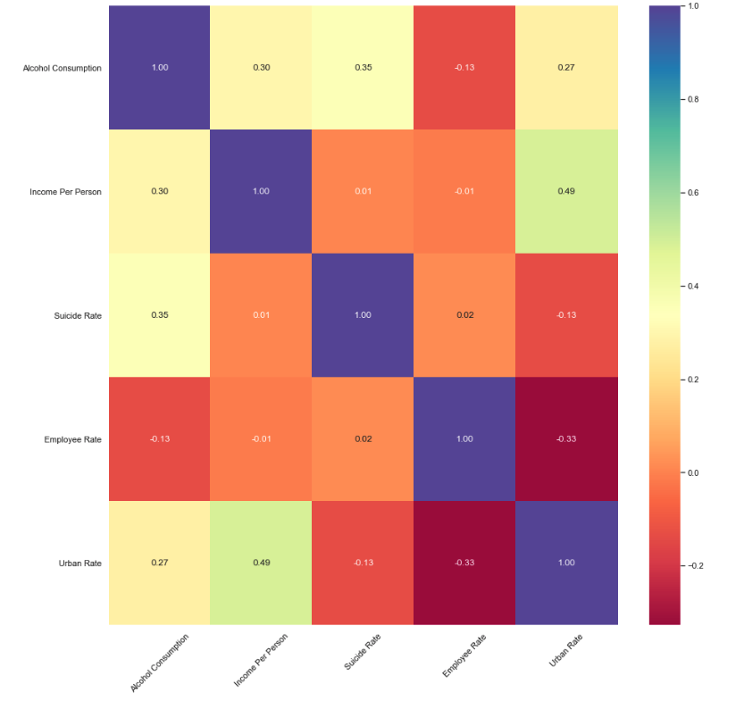

Visualizations - Data Set Heat Maps
Top 30
Entire Data Set

Slide 9
Summary
Summary
Summary of Findings
Project & Data Limitations
Highest consumers of alcohol are in Eastern Europe.
Alcohol consumption vs suicide rate was higher in our top 30 countries at 0.51 versus 0.35 for the world.
The correlation between income per person vs alcohol consumption was high for the entire data set at 0.30 and had a negative correlation for the top 30 countries at -0.35.
Urban rate vs alcohol consumption was low at -0.04 in our top 30 whereas for the rest of the world it was positive at 0.27.
The amount of data we could work with limited the data points to be analyzed
The number of comparable criteria by country also limited the full scope of insight we hoped to get.
Not all countries are similar due to culture, population, resources, etc.
We could not account for that in our data.

Slide 10



